Slide 1

Fintech Credit
Analytic Vision
Part 1 – Pushyami (Slides #3-8)
Part 2 – Prudvi (Slides # 9-14)
Part 3 – Pavan (Slides #15-19)
Part 4 – Sohitha (Slides #20-22)

Slide 2
Agenda
Company Overview
Business Trends & Segments
Vision, Mission & Values
Challenges
Chief Analytics Officer (CAO)
Group Organization Structure
Group Analytics Structure
CAO responsibilities with stakeholders
CAO Growth Plans For Scaling Group's Capabilities
Decision making
Analytical Group’s Visibility
Fintech Credit – Best Project Role
References
Fintech Credit – Tips we adopt
Fintech Credit – Challenges and Approach
Fintech Credit – Best Project
Best Project– Group’s visibility

Slide 3
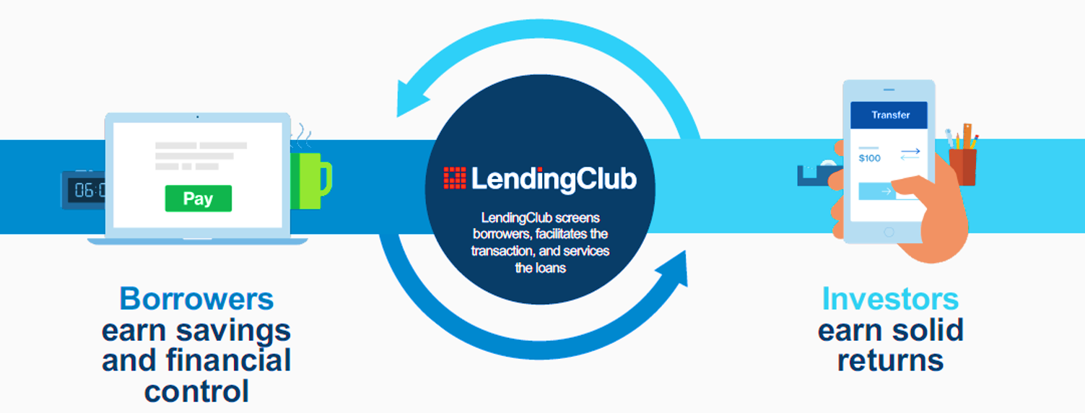

Fintech Credit – Business Model
Screens borrowers ,
Facilitates the transactions ,
Services the loans
Founded in 2010.
Operated in Australia & New Zealand.

Slide 4
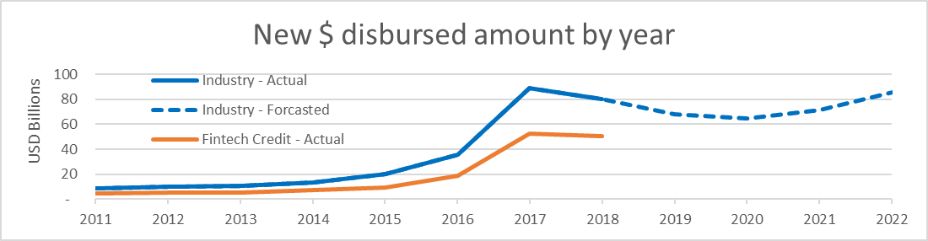
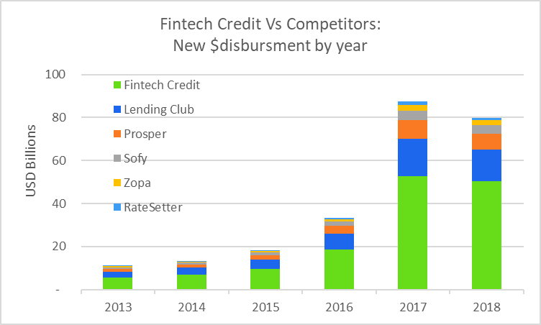
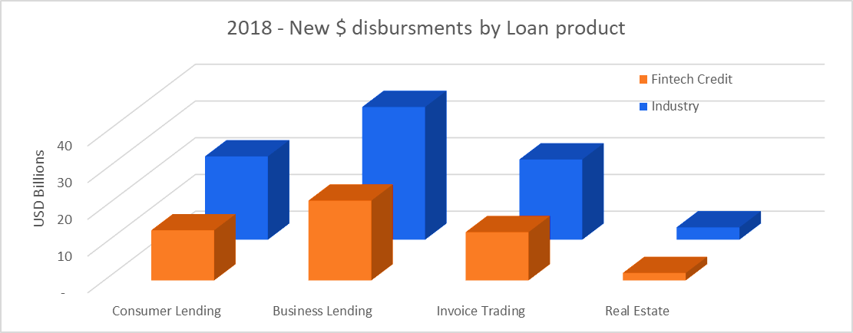
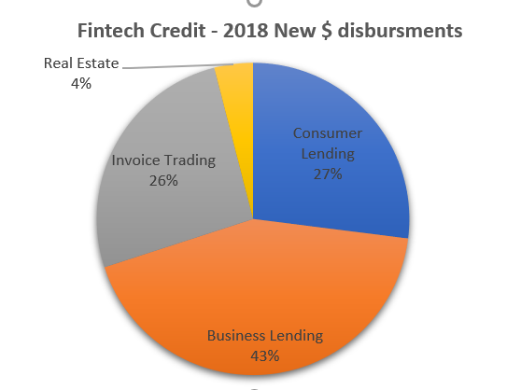
Business Trend
Market Share
Segments – By Share
Segments – By Value

Slide 5
Be a solution to
future lending
strategies
Enhanced, progressive and aligned growth in
- Marketing Strategies
- Business Strategies
- Strong Analytics
- Data & Technology
- Talent acquisition
- Commitment
- Collaboration
- Competence
- Transparency

Slide 6
Key challenges to scale up Analytics Strategy
Enhanced Marketing Strategies
Enhanced Business Strategies
Data & Technology
Collaboration
Competence
Direction, Scale and Intensity of the tasks & requirements should be driven by data with strong analytics framework.
The analytics framework should have good interaction with all key segments of the org structure
Breakdown of the strategy to key individual tasks. The timely monitoring and forecasting of such tasks should be prioritized and reported to relevant parties with relevant details.
How & Who?

Slide 7


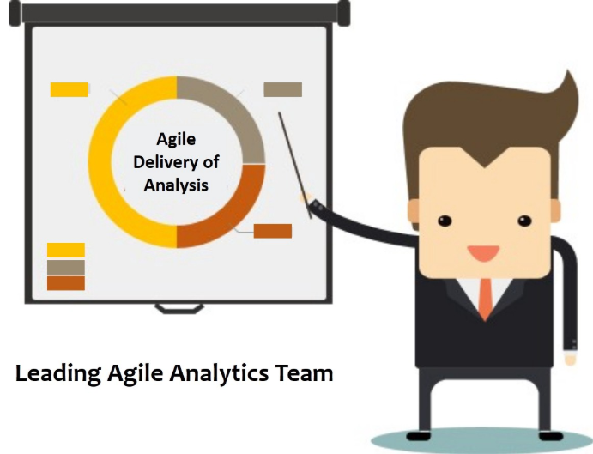




Role & Responsibilities
Enhanced Marketing Strategies
Enhanced Business Strategies
Data & Technology
Education
Bachelors in Computer Science,
Masters in Business Administration
Masters in Data science
An Actuary in Finance
Stakeholders
Marketing Team (Head)
Business Risk (CRO)
Finance (CFO)
Policy & Compliance (CPO)
Data & Technology (CIO)
Personality
Calm, Committed & Composed
Focused & Influential
An inspiring personality
Approachable
Chief Analytics Officer (CAO)
Work Experience
Principal Analyst - Lloyds Banking Group, England
Analytics lead - Barclays, England
Head of Analytics - Commonwealth Bank, Australia
Team
Reports to CEO
Analytics Strategy
Model Development
Model Validation
Model Oversight & Compliance
Reporting

Slide 8



Chief Executive Officer
(CEO)
New Analytics Team
Roles
Chief Finance Officer
(CFO)
Chief Risk Officer
(CRO)
Chief Information Officer
(CIO)
IT Team
Marketing Head
Chief Analytics Officer
(CAO)
Strategy Development & Review
Budget Finance
Accounting
Capital Risk
Credit Risk
Operational Risk
Data Collection
Data Processing
Data quality assessment
Software
Generation of digital platforms
Marketing Strategies
Brand Management
Analytics Strategy
Model Oversight & Compliance
Responsibilities
Model Development
Monitoring & Reporting
Model Validation

Slide 9
Chief Finance Officer
(CFO)
Chief Executive Officer
(CEO)
Strategy Development & Review
Chief Risk Officer
(CRO)
Analytics Strategy
Model Oversight & Compliance
Chief Analytics Officer
(CAO)
Model Development
Monitoring & Reporting
Chief Information Officer
(CIO)
Model Validation
Marketing Head
IT Team
CAO – Stakeholders
CAO – Working Team

Slide 10
Model Development
Lead – Responsible for the delivery of each component of model development.
Team – Responsible for the all components of model development including
Data requirements gathering
Data cleaning
Preparation of model data
Model development using machine learning algorithms
Impact Analysis
Model Validation
Lead – Responsible for the delivery of each component of model validation.
Team – Responsible for the all components of model validation including
Replication and quality assessment of data used for model development
Review of model design
Review of model performance using out of time/alternative data.
Review of model impact and relevance to the model requirements.
Analytics Strategy
Lead – Responsible for
Recognising and providing new analytical solutions to other group functions (Finance/Risk/Marketing/Data teams).
Timely review and track the status models in the organization
by usage (live/retired/under development/under validation/under approval/under implementation)
by type (risk/marketing/finance/group)
Timely review and track the performance of the live models in the organization

Slide 11
CFO:
Review and track the Budgets assigned for analytical projects
CRO:
Review and track compliance requirements and it’s implementation.
Marketing:
Review the marketing strategy.
Data:
Timely review and share the comments on data quality assessment.
IT team:
Implementation of analytical solutions,
Estimation of Cost and Time
Provide specifications
Review and track the implementation plan
Provide data requirements for analytical projects and track the deliveries.
Drive data team to develop and maintain an analytical data layer for effective data delivery
Provide analytical solutions to support marketing strategy.
Timely review and share the performance and impact of marketing strategy to the group.
Identify the key areas to enhance risk appetite.
Provide analytical solutions including origination scorecards, risk grading, optimization, forecasting, pricing.
Development and Enhancements to Financial models and Balance sheet analysis.

Slide 12
 | Short Term Plans | Middle-term plans | Long Term plans
Analytical Growth | Engage and provide performance monitoring reports for each stake holder with relevant details. Engage and explore the opportunities to enhance the efficiency and performance of internal process with analytical solutions | Engage and implement the timely layered performance monitoring reports holds different levels of details for each stake holder team leads, work managers and analysts . Update the risk, compliance, finance and marketing solutions with advanced machine learning techniques. | Implement fully functional machine learning and AI based digital platform to drive Origination strategies Risk optimization strategies Marketing strategies
Business Growth | FinTech companies that are addressing areas and functions where customer friction meets largest profit pools (economic value) FinTech companies that employ business models that are platform based, modular, data intensive, and capital light to start with | FinTech providers that offer services to the underserved population, small and mid-sized businesses, using sophisticated capabilities on viable basis FinTech companies that actively collaborate with Banks and other FIs and also operate within the regulatory purview or active consideration purview of regulators | FinTech companies that target customers and make curated offers through use of analytics and alternative / big data sources FinTech companies operating in segments with significant legacy issues and prevalence of conventional business models, that lack scalability FinTech companies that actively shape customer and user behaviors, thus resulting in long-term structural change of the financial services industry.

Slide 13
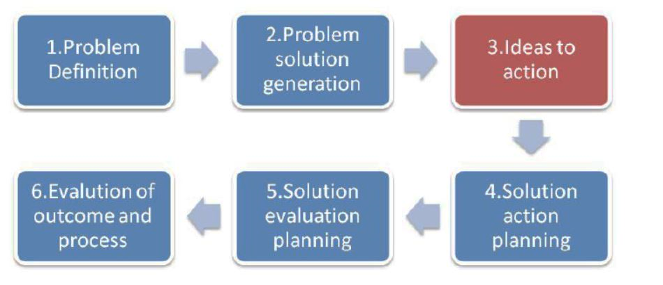
Decision making is a substantial interpersonal skill of each project manager to manage efficiency and conflicts of both working team and stake holders.
The present study focuses on the third step concerning the Ideas to action where projects teams need to define the criteria, rate the pros and cons of the alternatives and select the best among them.
The decision-making style should take into consideration three factors:
The quality (or correctness) of the decision, for those decisions that involve a high degree of expertise,
The required level of commitment to the decision by the group members and
The time available to make the decision.

Slide 14
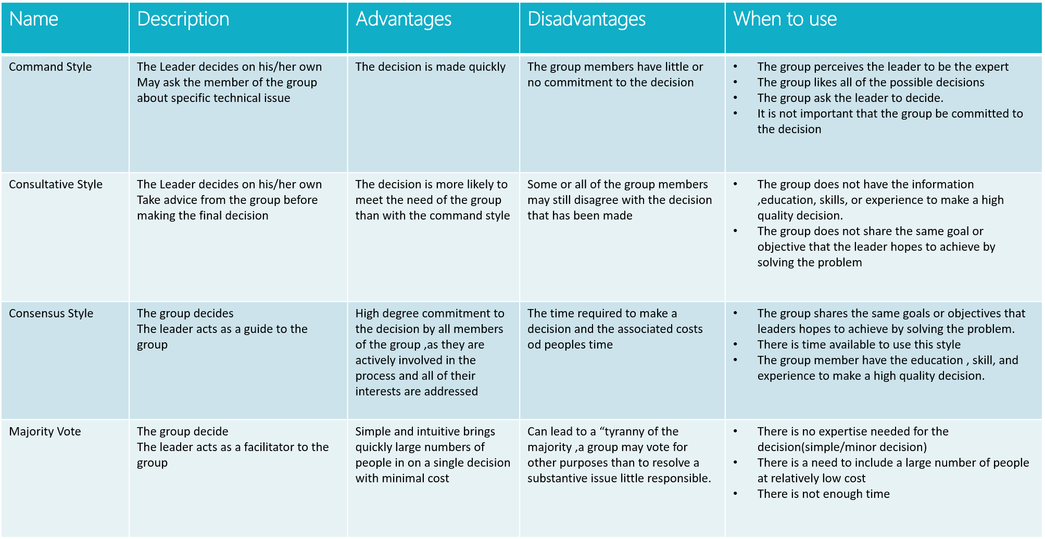

Slide 15

Strategies To Grow Our Analytics Team Visibility Within The Organization

Slide 16





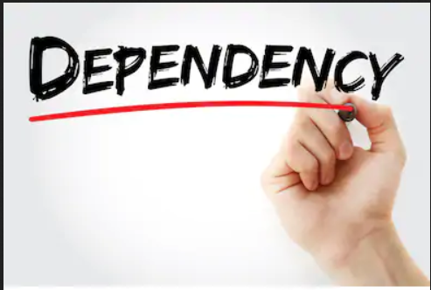

Fintech Credit – New Analytical Group’s Visibility
Choose the projects which benefits the larger part of the group. Scale-up such projects with reasonable time and cost.
Exploring opportunities to improve the efficiency of the current processes.
Analyze and articulate analytical solutions to identified issues in the current process.
Collaborate with other teams to create a win-win situation for the implementation of analytical solutions.
Manage Stake-holder's expectations and critical situations while developing and implementing analytical solutions.
Create dependency on analytical strategy team through the competence in data science and ability to turn over the relevant solutions in time .
Provide analytical solutions to increase both investors contribution and lending amounts In-line with marketing strategies.

Slide 17
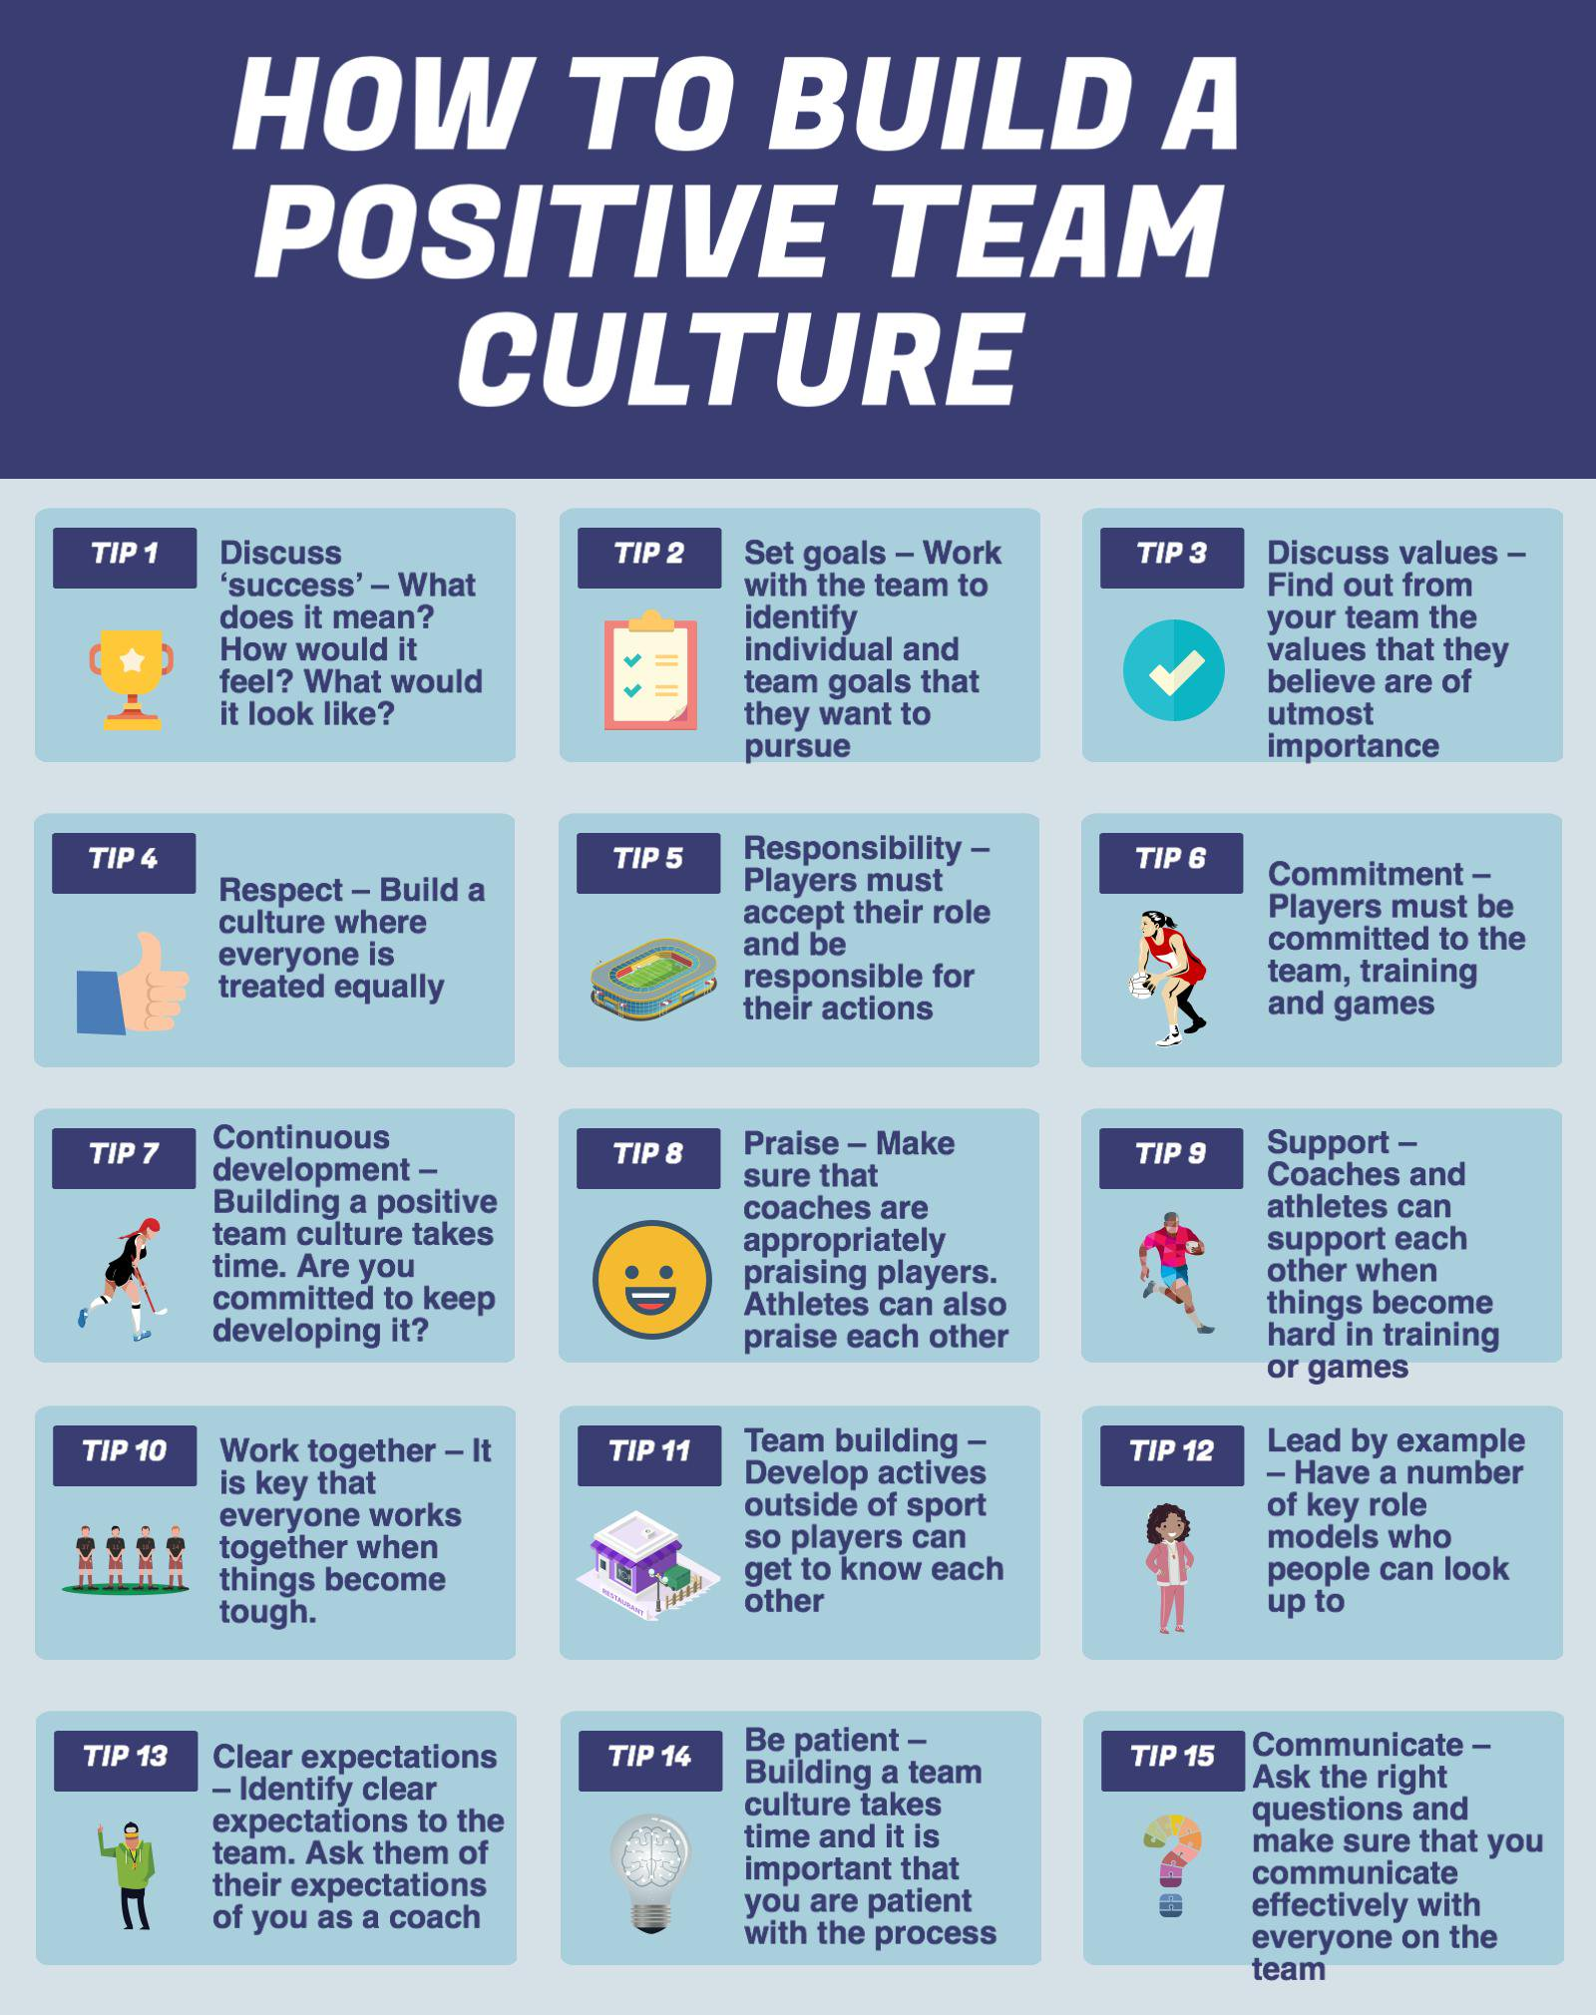
Fintech Credit – Tips we adopt

Slide 18
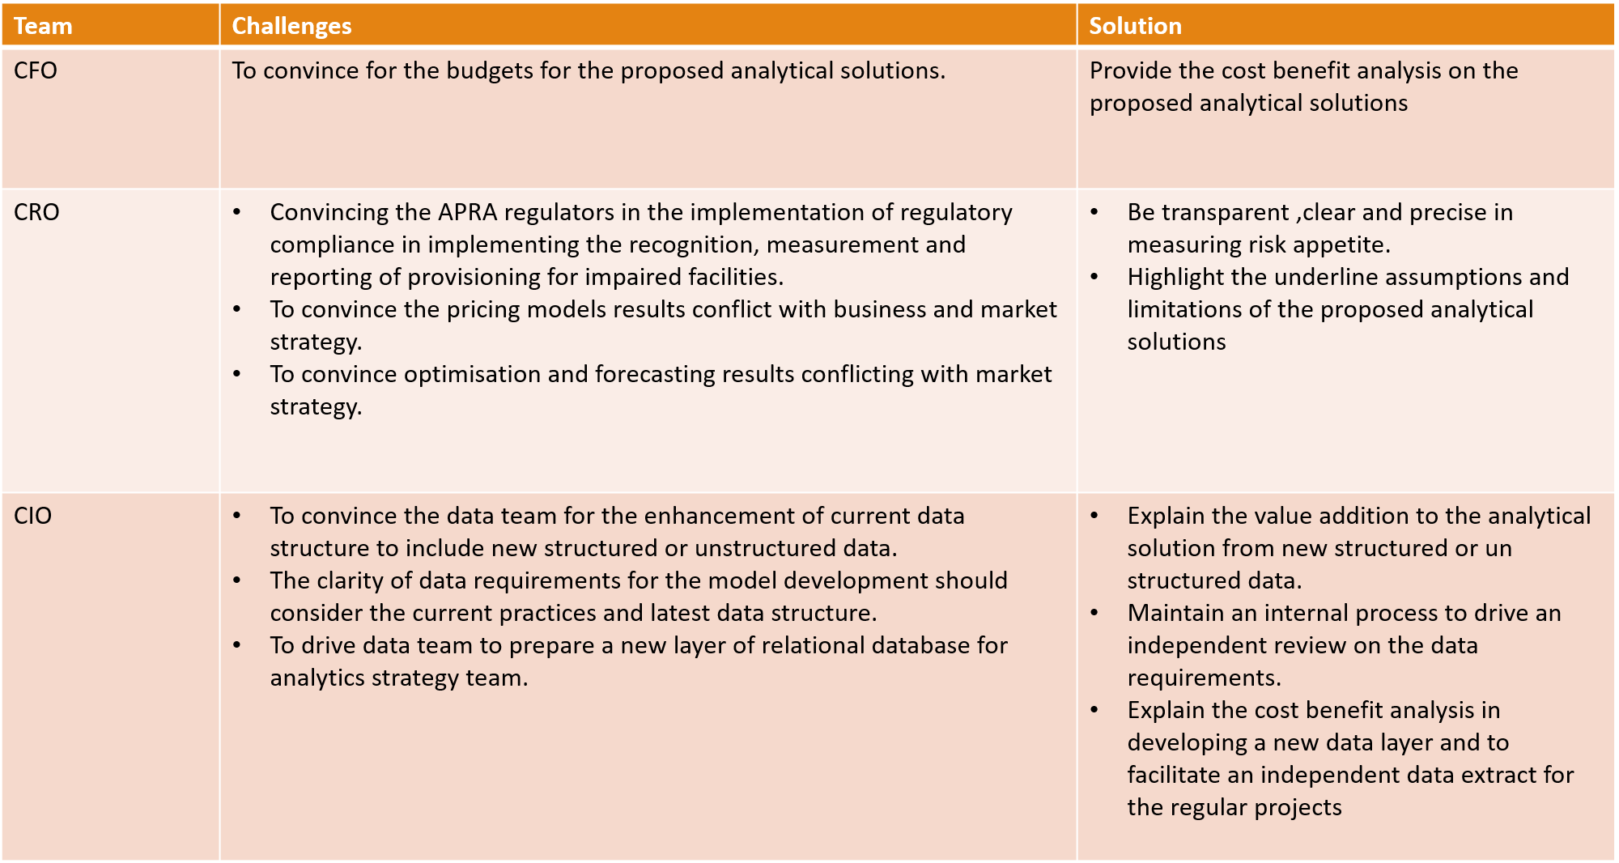
Fintech Credit – Challenges and Approach
Approach
Team Challenges Approach

Slide 19
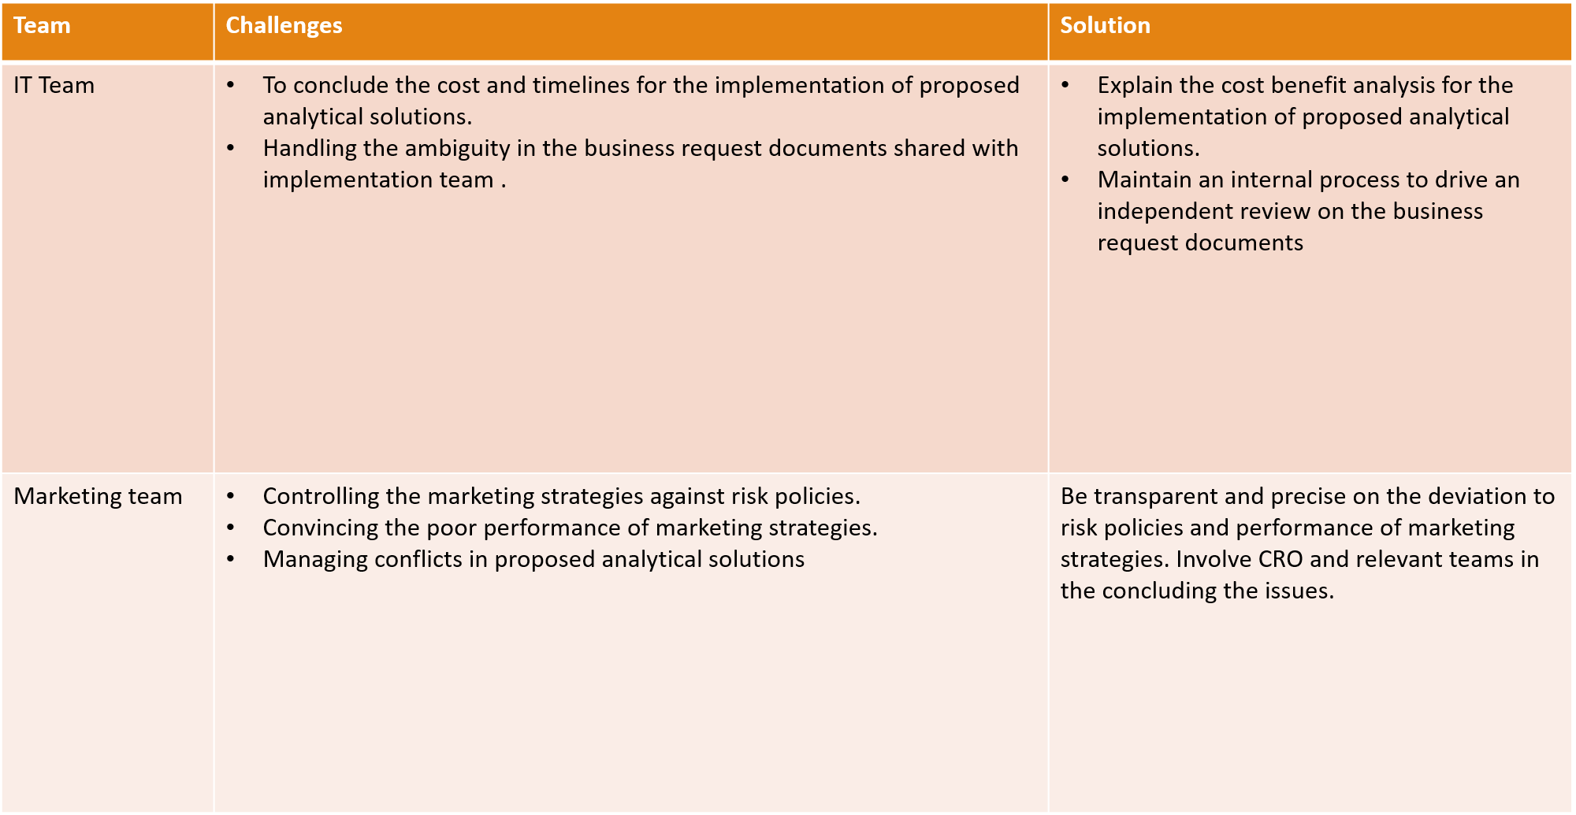
Fintech Credit – Challenges and Approach
Team Challenges Approach

Slide 20

Fintech Credit – Best Project
Which would be the best project to focus on for growing the analytics group's visibility and capabilities?
Fintech Credit is focusing on the development of lending activity in Business financing and Invoice financing.
Targets to achieve a 10 times growth in pooled investments from consumer/ business investors by 2022. This would be the best project to focus on for growing the analytics group's visibility and capabilities

Slide 21
Best Project– Group’s visibility
WHY?
For Fintech business transaction fee on successful lending drives profit. This project drives the analytical enhancements to support better risk grading of borrowers, optimization techniques to maximize investors profits, a quality and detailed reporting structure to monitor portfolio risk appetite.
Growing the group’s visibility:
This project creates a win-win situation for risk and marketing teams by providing effective optimization techniques helps raising investors deposits complaint with risk policy.
This project allows both risk and marketing teams to monitor portfolios growth not only at portfolio level but also by risk and market segments.
This project shows the competence of analytics team in raising the investors deposits complaint to risk policies.
The quality of the digital interface used for the implementation for the proposed analytical solutions should be internally reviewed. Further publish the results to other teams and address their feedback.

Slide 22
Fintech Credit – Best Project Role
What role will this project play in your larger strategy?
Contributes optimization strategies to manage the risk and profits for investors. This helps in reducing the gaps between the marketing strategies and risk policies.
Contributes to risk reporting with additional risk matrices related to both investors and borrowers credit risk.
Supports Fintech’s term goal of achieving growth in pooled investments.
Supports fintech’s long term goal of expansion of business in Asia and European countries.

Slide 23
References
https://www.pmi.org/learning/library/project-group-decision-making-process-6797
https://www.project-management-skills.com/organizational-structure-types.html
https://www.cmu.edu/teaching/designteach/teach/instructionalstrategies/groupprojects/challenges.html
https://www.workzone.com/blog/project-visibility-throughout-organization/
https://www.financialexpress.com/industry/sme/this-fintech-startup-is-nurturing-very-audacious-goal-of-financial-inclusion/1511617/

Slide 24
Thank You

